Slide 1



Access Audit
Empowering everyone to access & enjoy Rotary
Raising awareness of obstacles
Having fun, meeting new friends
Doing Good in The World

Slide 2

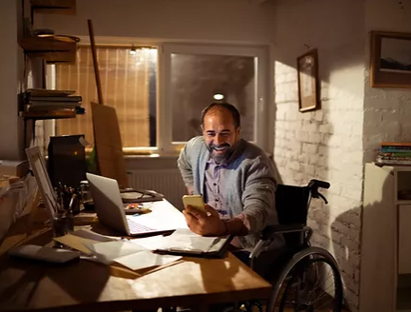
Rotary & Disability
We would like to help ensure that all children, young people and adults with disabilities are able to live a healthy, full and fulfilling life in the way they choose.
We want to see people living with disabilities becoming full citizens, members of their communities and part of the Rotary Family

Slide 3

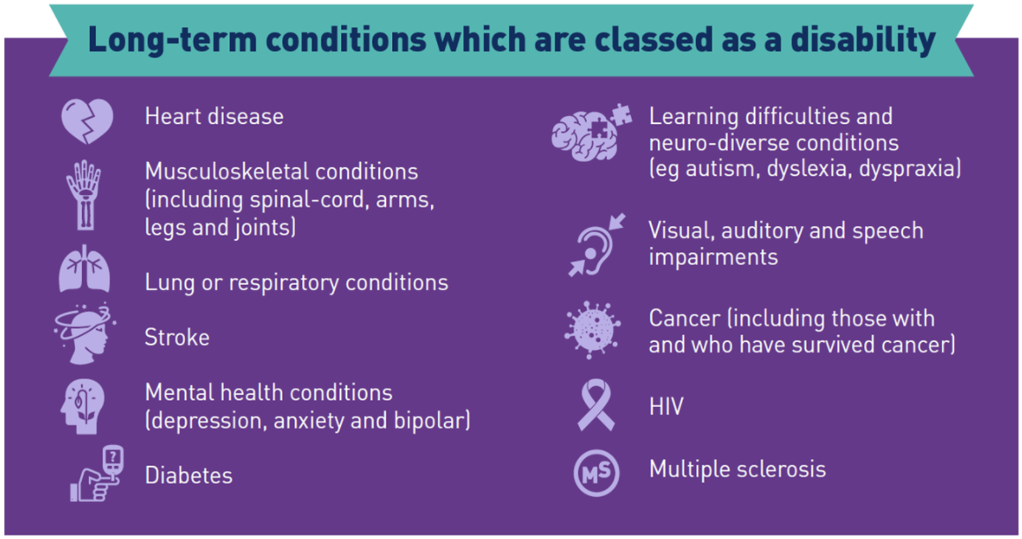

Slide 4


Disability facts and figures
There are 14.1 million disabled people in the UK
8% of children are disabled
19% of working age adults are disabled
46% of pension age adults are disabled
Source: Family Resources Survey (2019 to 20)

Slide 5


Common Barriers restricting Rotary Membership
Attitudinal
1 in 3 people see disabled folks as being less productive than non-disabled people.
Source: Scope - Disability Perception Gap (2018)
Communication
Barriers are experienced by people who have disabilities that affect their hearing, speaking, reading, writing and/or understanding, and who use different ways to communicate.

Slide 6

Transportation
Lack of buses, public transport, taxi costs; entry and exit access problems
Requirement to stop driving
Social
Physical
Changes in society remove barriers for everybody. It's better to change our environment and attitudes rather than try to change people with impairments or differences
Life costs you £583 more on average a month if you're disabled.
Source: Scope - The disability price tag (2019)

Slide 7


We will use an Access Audit checklist indicating access to the buildings and all internal facilities;
results will be simplified as a Traffic Light Coloured report
The Access Audit to include looking for
Immediate access to the building, steps, ramps, lighting, car park, lighting and surfaces
Are all areas available to wheelchair users?
Hearing Loop, Disability Toilets, Blue Badge Parking, etc
We will share these findings to
Enable Access for everyone

Slide 8

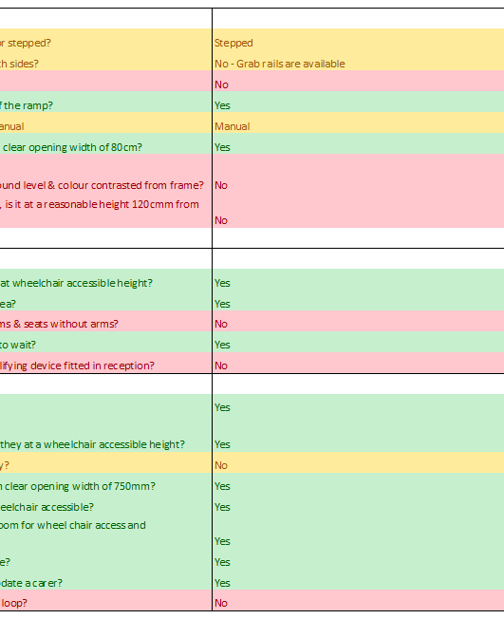
Access to Rotary
To carry out an
Access Audit
at your meeting venue
Please invite us to visit your Club
Visit all Rotary Club venues in D1210 to consider disability access

Slide 9


Rotary & Disability
Highlighting Rotary & Disability
Increase Awareness
Bring about Change
Include everyone
Increase Rotary Membership

